Slide 1

Website Accessibility – Why, When and How
Mayank Kumar

Slide 2

Started with WordPress at 17; Founder of two startups; Dreamer with a love for Coffee/Chai Open Source
Mayank Kumar
Founder, Web Wallah
Notes:
I am not a website access. Expert. I am just passionate about this so I am giving it here.

Slide 3
How many of you have heard about website accessibility before today?

Slide 4
What is Website Accessibility?
Notes:
Definition: Ensuring websites are usable by everyone, including people with disabilities.
Types of disabilities to consider: Visual, auditory, motor, and cognitive.
Accessibility improves UX for all users

Slide 5
How many of you have worked to make your website accessible?

Slide 6
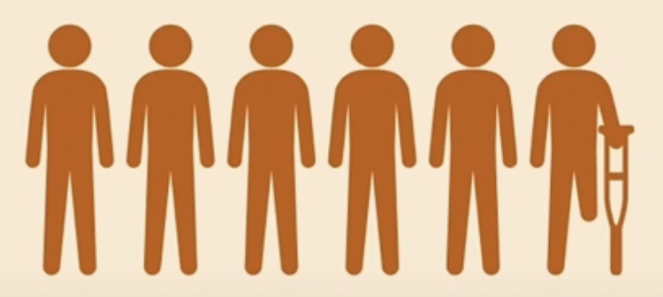
Based on information in a report from 2017, one in six people in the Asia-Pacific region lives with disability, and this was predicted to increase.*

Slide 7
Why Accessibility Matters?
Notes:
Ethical: Equal access is a fundamental right.
Legal: Avoid lawsuits by complying with accessibility standards (e.g., WCAG, ADA).
Practical: Expands your audience; 15% of the global population has disabilities.
SEO Benefits: Improves site ranking and visibility.

Slide 8
Ethical: Equal access is a fundamental right.
Legal: Avoid lawsuits by complying with accessibility standards (e.g., WCAG, ADA).
Practical: Expands your audience; 15% of the global population has disabilities.
SEO Benefits: Improves site ranking and visibility.
Notes:
Ethical: Equal access is a fundamental right.
Legal: Avoid lawsuits by complying with accessibility standards (e.g., WCAG, ADA).
Practical: Expands your audience; 15% of the global population has disabilities.
SEO Benefits: Improves site ranking and visibility.

Slide 9
The Impact of Inaccessible Websites
Missing alt text, poor color contrast, no keyboard navigation.
Notes:
Ethical: Equal access is a fundamental right.
Legal: Avoid lawsuits by complying with accessibility standards (e.g., WCAG, ADA).
Practical: Expands your audience; 15% of the global population has disabilities.
SEO Benefits: Improves site ranking and visibility.

Slide 10
When to Consider Accessibility
Notes:
Ethical: Equal access is a fundamental right.
Legal: Avoid lawsuits by complying with accessibility standards (e.g., WCAG, ADA).
Practical: Expands your audience; 15% of the global population has disabilities.
SEO Benefits: Improves site ranking and visibility.

Slide 11
During Development: Incorporate accessibility from the start.
During Updates: Regularly test and update your website for compliance.
Ongoing: Accessibility is a continuous process.
Notes:
Ethical: Equal access is a fundamental right.
Legal: Avoid lawsuits by complying with accessibility standards (e.g., WCAG, ADA).
Practical: Expands your audience; 15% of the global population has disabilities.
SEO Benefits: Improves site ranking and visibility.

Slide 12
How to Implement Accessibility
Notes:
Ethical: Equal access is a fundamental right.
Legal: Avoid lawsuits by complying with accessibility standards (e.g., WCAG, ADA).
Practical: Expands your audience; 15% of the global population has disabilities.
SEO Benefits: Improves site ranking and visibility.

Slide 13
Use semantic HTML and ARIA roles.
Add alt text for images and captions for videos.
Ensure sufficient color contrast.
Test with screen readers and keyboard navigation.
Notes:
Ethical: Equal access is a fundamental right.
Legal: Avoid lawsuits by complying with accessibility standards (e.g., WCAG, ADA).
Practical: Expands your audience; 15% of the global population has disabilities.
SEO Benefits: Improves site ranking and visibility.

Slide 14
Tools and Resources
Notes:
Ethical: Equal access is a fundamental right.
Legal: Avoid lawsuits by complying with accessibility standards (e.g., WCAG, ADA).
Practical: Expands your audience; 15% of the global population has disabilities.
SEO Benefits: Improves site ranking and visibility.

Slide 15
Axe, WAVE, Lighthouse, NVDA
Notes:
Ethical: Equal access is a fundamental right.
Legal: Avoid lawsuits by complying with accessibility standards (e.g., WCAG, ADA).
Practical: Expands your audience; 15% of the global population has disabilities.
SEO Benefits: Improves site ranking and visibility.

Slide 16
Make your website accessible today! Start small, but start now.
Notes:
Ethical: Equal access is a fundamental right.
Legal: Avoid lawsuits by complying with accessibility standards (e.g., WCAG, ADA).
Practical: Expands your audience; 15% of the global population has disabilities.
SEO Benefits: Improves site ranking and visibility.

Slide 17
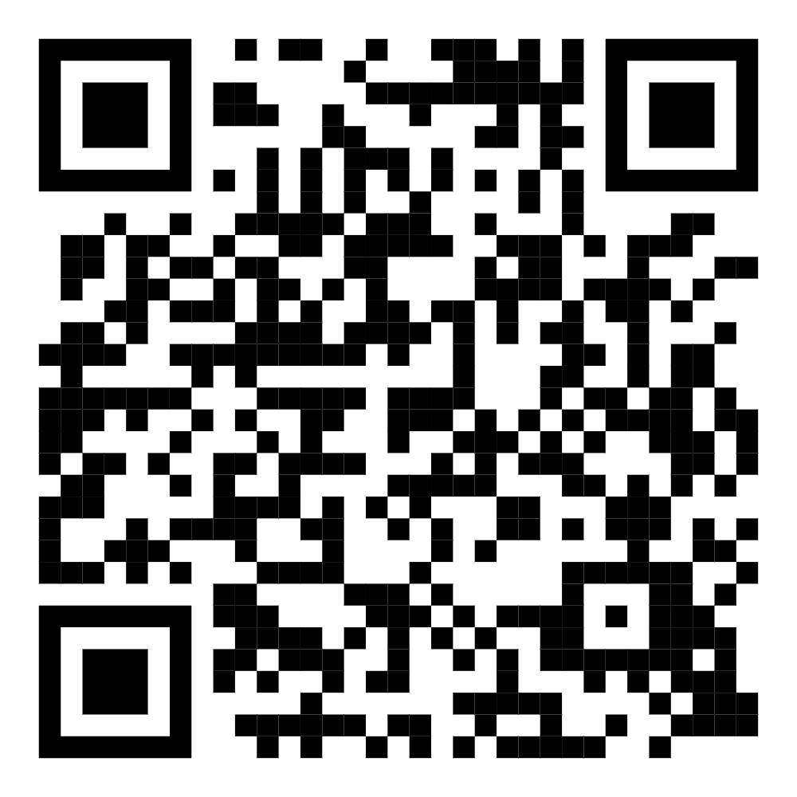
@markmemayank

Slide 18


Thank You

