Slide 1

WordPress Plugin Development
From Idea to Marketplace
Prem Tiwari

Slide 2

About Me
I am Prem Tiwari from Bengaluru and working as Lead Engineer in News Corp.
Linkedin: @thepremtiwari
Twitter: @thepremtiwari
Instagram: @thepremtiwari
WordPress: @freewebmentor

Slide 3
WordPress Plugin
Introduction
Conceptualizing the Idea
Plugin Development
Test Your Plugin
Publishing on WordPress.org
Promoting Your Plugin
Monetize Your Plugin

Slide 4

WordPress Plugin
What are WordPress Plugins?: WordPress plugins are tools that add specific functionalities to a WordPress site, enabling customization without altering core code.
Market Significance: As of 2024, there are over 59,000+ plugins on WordPress.org, with a thriving market for premium plugins generating millions annually.
Who is this for?: Aspiring developers looking to create impactful solutions and distribute them through the WordPress ecosystem.

Slide 5



Conceptualizing the Idea
Turning Concepts into Realities
Identifying the Need
Analyze market demands, user pain points, and gaps in existing plugins.
Validating Your Idea
Conduct surveys, interact with potential users, and gather feedback to confirm feasibility.
Documentation and Planning
Define core features, outline functionality, and create a roadmap for development.

Slide 6
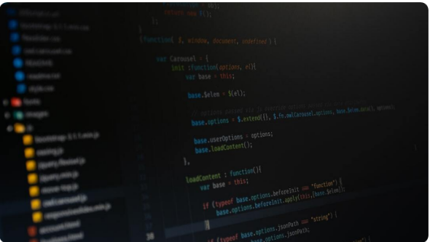
Plugin Development
Building Your Plugin
Setting Up the Environment: Install local WordPress setups like XAMPP or Local by Flywheel for development.
Creating the Plugin Structure: Define folders and files such as main PHP file, readme.txt, and assets folder.
Core Coding Practices: Follow WordPress coding standards and use hooks, filters, and actions effectively.

Slide 7



Test Your Plugin
Ensuring Plugin Quality
Debugging Techniques
Utilize tools like Query Monitor and WP_DEBUG to identify and resolve issues.
Performance Testing
Test your plugin's impact on site speed using tools like GTmetrix and PageSpeed Insights.
User Acceptance Testing (UAT)
Collect feedback from real users to ensure functionality aligns with expectations.

Slide 8
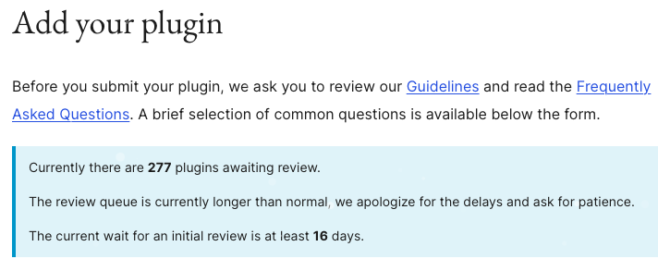
Plugin Deployment
Publishing on WordPress.org
Packaging Your Plugin: Ensure all files are properly organized, include documentation, and create a zip file for distribution.
Compatibility Checks: Test compatibility with different WordPress versions and popular themes or plugins.
Respond to Feedback: Address user reviews and update the plugin regularly.
Submission Process: Follow plugin repository guidelines and submit your plugin.

Slide 9

Promote Your Plugin
Leverage social media
Create a Landing Page: Highlight features and benefits.
Share on Social Media: Engage with the WordPress community.
Leverage Email Marketing: Send updates to your subscribers.

Slide 10

Monetize Your Plugin
Making Your Plugin Profitable
Freemium Model
Offer a basic version for free and monetize advanced features through a premium version.
Direct Sales and Licensing
Sell directly from your website using WooCommerce or similar solutions.

Slide 11

Thank you & Happy Coding!
👨🏽‍💻

