Slide 1

CREATE CUSTOM WIDGET
INTO ELEMENTOR
Suraj G. Sutar
MANAGER AT WALSTAR TECHNOLOGIES PVT. LTD.

Slide 2

About Me
Hi…
This is Suraj Sutar, Manager at Walstar Technologies Pvt. Ltd. With over 7 years of experience in WordPress development, I've helped businesses build custom websites, optimize performance, and create tailored solutions to meet their unique needs. My expertise spans everything from crafting custom code to integrating advanced functionalities using tools like Elementor.
I'm also an active member of the WordPress community and a mentor to aspiring developers. Excited to be a speaker at WordCamp Kolhapur 2025, I'll be sharing insights on creating custom widgets in Elementor. WordPress isn't just my profession—it's my passion and a tool that empowers me to help businesses grow.

Slide 3
Key Points
    Introduction to Elementor
    Need for Custom Widgets
    Creating Custom Widgets
    Extending Functionality
    Live Demo
    Q&A

Slide 4
Introduction
to Elementor
Overview of Elementor
Drag-and-drop builder for WordPress
Simplifies site customization
Importance of Widgets
Crucial for tailoring design and functionality

Slide 5
Need for
Custom Widgets
Why Create Custom Widgets
Default options may not meet unique design
needs
Benefits
Enhanced flexibility for developers
Improved user experience

Slide 6
Creating
Custom Widgets
Key Steps to Build Custom Widgets :
Develop a custom plugin
Register the widget with Elementor API
Define widget controls
Render content dynamically

Slide 7
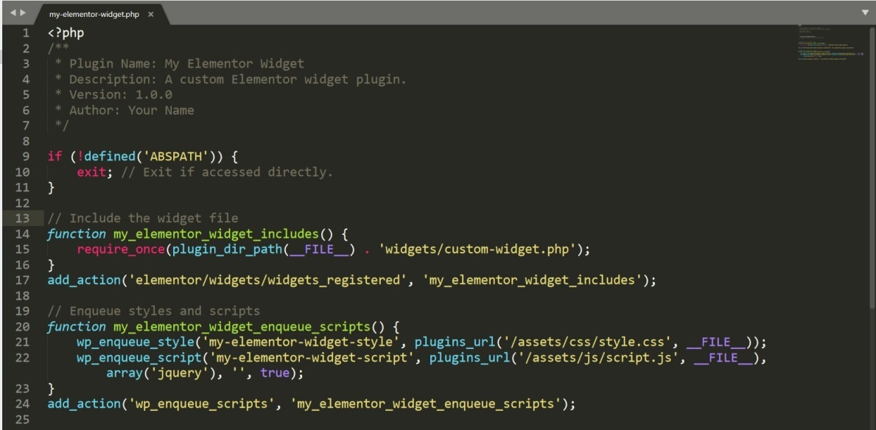
Develop a
Custom Plugin
How to create Custom Plugin and using that add widget into Elementor

Slide 8
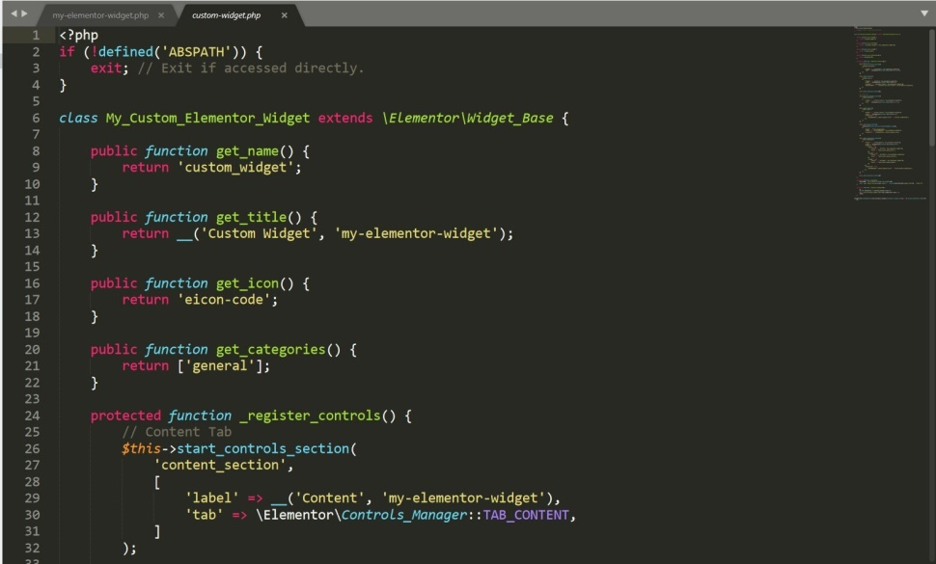
Develop a
Custom Plugin
How to create Custom Plugin and using that add widget into Elementor

Slide 9
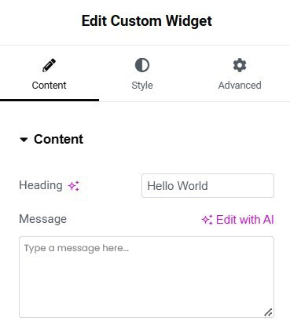
Elementor
Input Type
'type' => \Elementor\Controls_Manager::TEXT
'type' => \Elementor\Controls_Manager::TEXTAREA
'type' => \Elementor\Controls_Manager::NUMBER
'type' => \Elementor\Controls_Manager::URL
'type' => \Elementor\Controls_Manager::EMAIL
'type' => \Elementor\Controls_Manager::COLOR
'type' => \Elementor\Controls_Manager::MEDIA
'type' => \Elementor\Controls_Manager::SELECT
'type' => \Elementor\Controls_Manager::SELECT2

Slide 10
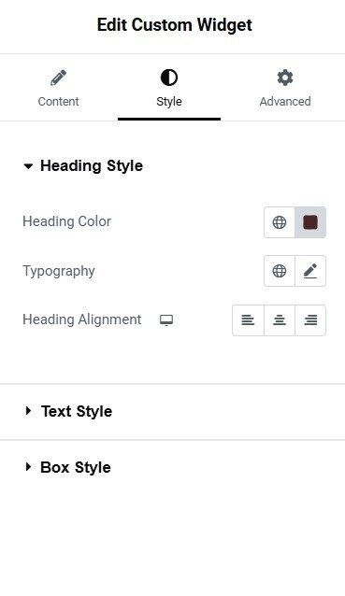
Extending
Functionality
Adding Style Option to your widget

Slide 11
Q&A
Feel free to ask any questions!

Slide 12






THANK YOU
धन्यवाद
Suraj G. Sutar

